Slide 1
Mean, Median & Mode
Let’s Start Learning with practical examples :-

Slide 2
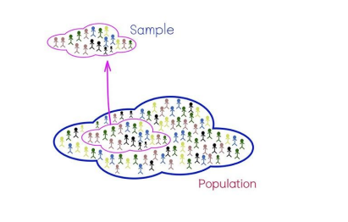
Population and Sample :-
● A population is the collection of all items of interest to our study and is usually
denoted with an uppercase N. The numbers we obtain when using a population
are called parameters.
● A Sample is a subset of the Population and is usually denoted with lowercase n,
and the numbers we obtain when working with a sample are called statistics.
n denotes sample
Sample - Statistics
N denotes Population
Population – Parameters
Sampling
Eg. Exit Polls during Elections

Slide 3
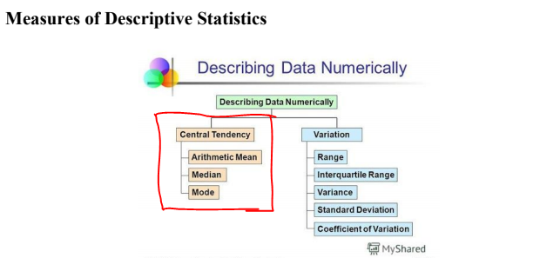
Descriptive Statistics
Descriptive statistics helps to describe and understand the features of a specific dataset .
With descriptive statistics you are simply describing what is or what the data shows.

Slide 4
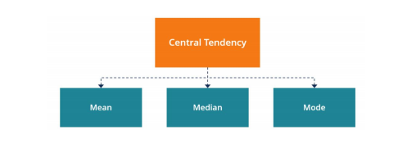
Measures of central tendency:-
They describe the center of a data set. Although it does not provide information regarding
the individual values in the dataset, it delivers a comprehensive summary of the whole dataset.
Mean: Average defined as ratio of the summation of all values to the number of items.
Data Set Weight of 10 males,
55, 56, 56, 58, 60, 61, 63, 64, 70, 78.
The mean weight is calculated as,
Mean = (55 + 56 + 56 + 58 + 60 + 61 + 63 + 64 + 70 + 78) / 10 = 62.1
Mean Formula = ∑X ÷ N
∑X= Sum of all the individual values,
N= Total number of items

Slide 5
Median: It is essentially known as the central value of a series. Median of a set of
values can be arrived only after sorting the data in either ascending or descending order
X = 3, 6, 8, 3, 9, 1, 7
Y = 3,6,8,3,9,1,7,8
Sorted X = 1, 3, 3, 6, 7, 8, 9 (Odd)
Median of X = 1, 3, 3, 6, 7, 8, 9
Median = 6
Count of numbers is odd: Median= (n+1)/2 th Term (4rth Observation)
Sorted Y = 1,3,3,6,7,8,8,9(Even)
Median of Y = 1,3,3, 6,7, 8,8,9
Median = (6 + 7)/2 = 6.5
Count of numbers is even: Median= (n/2)term +(n/2)+1th Terms/2 - (4rth + 5th Observation)/2

Slide 6
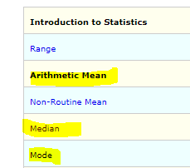
Mode: Mode is the most frequently occurring number in the dataset.
Let us take an example of mode 89, 65, 11, 54, 11, 90, 56.
Here in these varied observations the most occurring number
is 11, hence Mode=11
Exercises :-
For practice you can go to the below URL and complete the question in the List.
https://www.mathgoodies.com/lessons/vol8/median

Slide 7
EXERCISE :-
1.)Find the median weight of 5 seventh grade students whose weights in pounds are listed below. 82 lb, 102 lb, 75 lb, 91 lb, 89 lb
Answ:- 89
2.)The ages of 10 college students are listed below. Find the median. 18, 24, 20, 35, 19, 23, 26, 23, 19, 20
Answ: 21.5
3.)Find the mean of the whole numbers listed below. 1, 8, 7, 6, 8, 3, 2, 5, 4, 5
Answ: 4.9
4.)Find the mean rounded to the nearest tenth. 0.34, 0.12, 0.48, 0.56, 0.71, 0.8, 0.65, 0.82
Answ: .6
5.) A marathon race was completed by 5 participants. What is the mode of these times given in hours?
2.7 hr, 8.3 hr, 3.5 hr, 5.1 hr, 4.9 hr
Answ : There is no mode here
6.) Find mode in the below dataset? 132, 121, 119, 116, 130, 121, 131, 117, 119, 135, 121, 129, 119, 134
Answ :- 119 & 121 are mode for the sample set

